Slide 1
No. 15

Slide 2
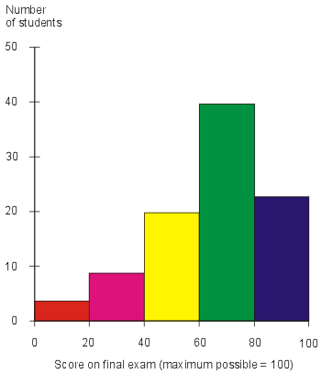
Histogram
Histogram is series of joint Rectangles
Histogram

Slide 3
To draw a histogram :
Class should be continuous
CLASSES
Discontinuous Classes
Continuous Classes
Not same
1 - 10
Same
0 - 10
11 - 20
10 - 20
21 - 30
20 - 30

Slide 4
How to make classes continuous
Find Difference between any consecutive lower and upper limits.
21 – 20 = 1
1
Divide the difference value by 2.
difference
÷ 2 = 0.5
Subtract the value from the lower limit and add it to the upper limit.
11 – 0.5 = 10.5
21 – 0.5 = 20.5
31 – 0.5 = 30.5
20 + 0.5 = 20.5
30 + 0.5 = 30.5
40 + 0.5 = 40.5
Continuous
class
Class Interval
11 - 20
10.5 - 20.5
21 - 30
20.5 - 30.5
31 - 40
30.5 - 39.5

Slide 5
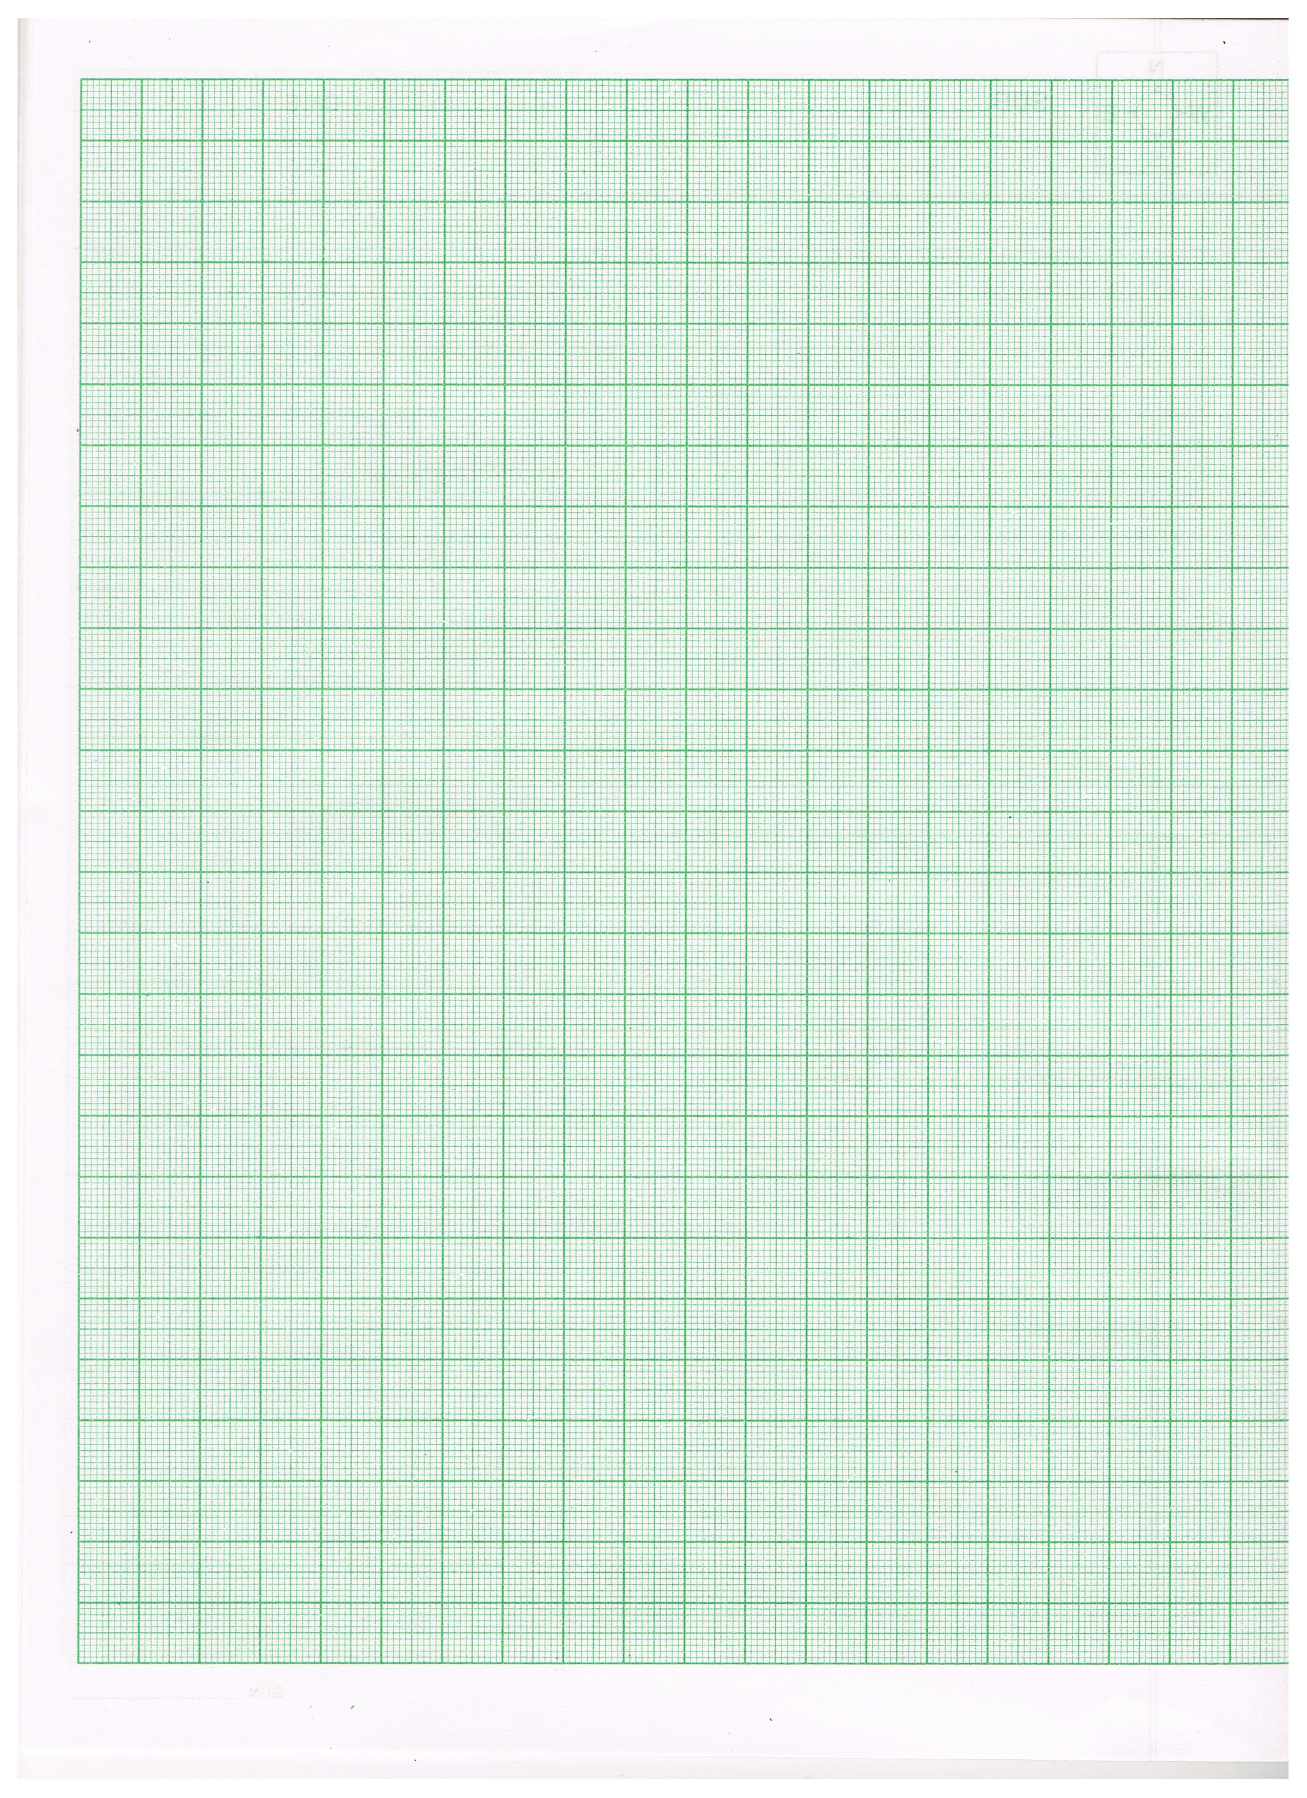
To draw histogram :
Y
Class should be continuous
Scale :
Draw X axis and Y axis
Scale
Frequency on Y axis
Maximum frequency | Ideal Scale for Y axis
Up to 20 | 1 cm = 1 unit
Up to 40 | 1 cm = 2 units
Frequency
Class Interval on X axis
X’
0
Class Interval
X
Y’

Slide 6
To draw histogram :
Y
Scale :
On X axis:1cm = 5 cm height
This mark is called as ‘Krink’ mark
Scale :
On Y axis:1 cm = 1 student
9
8
7
6
Frequency
5
No. of students
4
3
2
1
X’
0
140
145
150
155
160
165
X
Class Interval
Y’
Height of students in cm

Slide 7
If the size of the classes is not same then we need to adjust the frequency
Minimum class-size
Adjusted frequency for a class
=
×
its frequency
Class - size of present class

Slide 8
No. 16

Slide 9
Y
Scale :
Q. Represent the following data using histogram.
On X axis:2 cm = 5 cm height
12
Height of students(cm.) | 140 - 144 | 145 - 149 | 150 - 154 | 155 - 159
Number of students | 2 | 12 | 10 | 4
On Y axis:1 cm = 1 student
11
Divide the difference value by 2
Classes are discontinuous and their size is same
Since we have 20 cms on
Y-axis, we will consider simplest scale 1 cm = 1 unit
Subtract the value from the lower limit and add it to the upper limit.
Scale is always gap in cm equal to difference with units
Sol:
10
Height of
students (cm.)
Continuous classes
Mark frequencies on
Y-axis
Find Difference between upper limit & lower limit of next class.
Number of
students
9
145 – 144 = 1
For each class draw rectangle of length equal to its frequency
8
1 ÷ 2 = 0.5
140 - 144
139.5 – 144.5
2
What is the highest frequency?
7
12
140 – 0.5 = 139.5
144.5 – 149.5
12
145 - 149
No. of students
6
144 + 0.5 = 144.5
Let us make the classes continuous
Since difference is not same we will put krink mark on X-axis
Check the difference between first limit & ‘0’
& also between second & first limit
150 - 154
149.5 – 154.5
10
5
155 - 159
4
4
Frequency 2
154.5 – 159.5
3
Mark class limits on
X-axis
As classes are not starting from ‘0’ leave space of 2 cm from origin on X-axis
Mark 1st class limit 139.5
Mark class limits on X-axis with a gap of 2 cm
139.5 – 0
= 139.5
2
144.5 – 139.5
Check if the classes are starting from ‘0’
1cm
144.5 – 139.5
= 5
No
= 1 units
= 5 units
1
2 cm
Lower limit 139.5
Upper limit 144.5
X′
0
139.5
144.5
149.5
154.5
159.5
X
Y′
Height of students in cm

Slide 10
No. 17

Slide 11
Y
Scale :
Q. Draw the histogram to represent the following data.
On X axis:2 cm = Rs. 1000
Daily sales of a store in (Rs.) | 0 – 1000 | 1000 – 2000 | 2000 – 3000 | 3000 – 4000 | 4000 – 5000 | Total
No. of days in a month | 2 | 12 | 10 | 4 | 2 | 30
12
Classes are continuous and their size is same
On Y axis:1 cm = 1 Day
11
10
Scale is always gap in cm equal to difference with units
Sol:
Mark frequencies on
Y-axis
9
Daily sales of
a store in (Rs.)
No. of days in a month
8
For each class draw rectangle of length equal to its frequency
Since we have 20 cms on
Y-axis, we will consider simplest scale 1 cm = 1 unit
7
What is the highest frequency?
0 - 1000
2
12
No. of days in a month
1000 - 2000
6
12
5
Since difference is same we will not put krink mark on X-axis
Check the difference between first limit & ‘0’
& also between second & first limit
2000 - 3000
10
4
3000 - 4000
4
3
Mark class limits on
X-axis
2
1000 – 0
= 1000
4000 - 5000
2
2000 – 1000
= 1000
1
Total
30
X’
0
1000
2000
3000
4000
5000
X
Y’
Daily Sales of a store in (Rs.)

Slide 12
No. 18

Slide 13
Q.] The length of 40 leaves of a plant are measured correct to one millimeter,
and the obtained data is represented in the following table : Draw histogram.
Length (in mm)
118 – 126
127 – 135
Divide the difference value by 2
136 – 144
145 – 153
154 – 162
163 – 171
172 – 180
Subtract the value from the lower limit and add it to the upper limit.
Number of leaves
3
5
9
12
5
4
2
Classes are discontinuous and their size is same
Sol.
Find Difference between upper limit & lower limit of next class.
127 – 126 = 1
1 ÷ 2 = 0.5
Length (in mm)
Continuous class
Number of leaves
3
118 – 0.5 = 117.5
118 – 126
117.5 – 126.5
126 + 0.5 = 126.5
127 – 135
126.5 – 135.5
5
Let us make the classes continuous
136 – 144
135.5 – 144.5
9
145 – 153
144.5 – 153.5
12
154 – 162
153.5 – 162.5
5
163 – 171
162.5 – 171.5
4
172 – 180
171.5 – 180.5
2

Slide 14
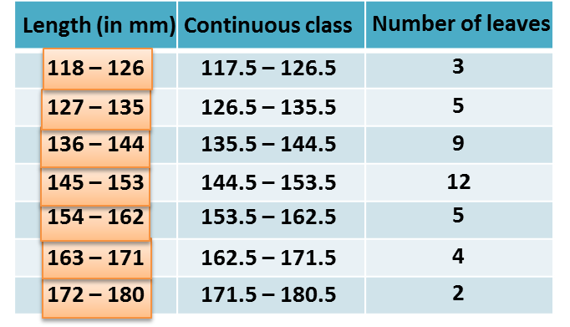
Y
Scale :
12
On X axis:2 cm = 9 mm length
On Y axis:1 cm = 1 leaf
11
12
10
Scale is always gap in cm equal to difference with units
Mark frequencies on
Y-axis
Since we have 20 cms on
Y-axis, we will consider simplest scale 1 cm = 1 unit
9
For each class draw rectangle of length equal to its frequency
8
What is the highest frequency?
7
Number of leaves
6
Since difference is not same we will put krink mark on X-axis
5
Check the difference between first limit & ‘0’
& also between second & first limit
Frequency 3
4
Mark 1st class limit
117.5
No
3
126.5 – 117.5
Mark class limits on
X-axis
As classes are not starting from ‘0’ leave space of 2 cm from origin on X-axis
117.5 – 0
= 117.5
Mark class limits on X-axis with a gap of 2 cm
2
= 9 units
126.5 – 117.5
= 9
Lower limit 117.5
1cm Unit
1
2 cm
Upper limit 126.5
X′
0
117.5
126.5
135.5
144.5
153.5
162.5
171.5
180.5
X
Y′
Length (in mm)

Slide 15
No. 19

Slide 16
Y
Scale :
Q.] The following table gives the life times of 400 neon lamps :
(i) Represent the given information with the help of a histogram.
(ii) How many lamps have a life time of 700 or more than 700 hours?
On X axis:2 cm = 100 hrs
Mark frequencies on
Y-axis
On Y axis:1 cm = 10 lamps
Life time (in hours)
300 – 400
400 – 500
500 – 600
600 – 700
700 – 800
800 – 900
900 – 1000
100
Classes are continuous and their size is same
Scale is always gap in cm equal to difference with units
Number of lamps
14
56
60
86
74
62
48
Since we have 20 cm on
Y-axis, we will consider simplest scale 1 cm = 10 units
Sol.
90
Life time
(in hours)
Number
of lamps
80
70
Number of Lamps
What is the highest frequency?
300 – 400
14
86
For each class draw rectangle of length equal to its frequency
60
Check the difference between first limit & ‘0’
& also between second & first limit
Since difference is same we will not put krink mark on X-axis
400 – 500
56
50
500 – 600
60
40
600 – 700
86
30
Mark class limits on
X-axis
700 – 800
74
20
300 – 0
= 300
800 – 900
62
300 – 400
= 100
900 – 1000
48
10
X’
0
300
400
500
600
700
800
900
1000
X’
X
Y’
Life Time (in hours)

Slide 17
Q.] The following table gives the life times of 400 neon lamps :
(i) Represent the given information with the help of a histogram.
(ii) How many lamps have a life time of 700 or more than 700 hours?
Life time (in hours)
300 – 400
400 – 500
500 – 600
600 – 700
700 – 800
800 – 900
900 – 1000
Number of lamps
14
56
60
86
74
62
48
Sol.
Number of lamps having lifetime of 700 or more than 700 hours
=
74 + 62 + 48
=
184
∴ 184 lamps have a lifetime of 700 or more than 700 hours.

Slide 18
No. 20

Slide 19
Q.) The class marks of a distribution are given below
Class Marks | 5 | 15 | 25 | 35 | 45 | 55 | 65 | 75
Determine the class size, the class limits.
Class mark is mid point of classes
Let us find class limits
Sol:
Class marks
Class interval
Class size = 10
Let us find class size using given class marks
Lower limit of 1st class =
5 -
10
2
5
0 – 10
= 0
15
10 – 20
Difference between consecutive class marks is the class size
Upper limit of 1st class =
5 +
10
2
25
20 – 30
= 10
35
30 – 40
45
First class is 0 – 10
40 – 50
35 – 25 = 10
55
50 – 60
65
60 – 70
75
70 – 80

Slide 20
Q.) Draw a histogram for the marks of students given below:
Marks
Number of students
0 – 10
8
10 – 30
32
30 – 45
18
45 – 50
10
50 – 60
6
Soln.
(i) In the given frequency distribution, we see that the class-sizes are different.
Hence, we calculate the adjusted frequency for each class by using the formula :
Minimum class-size
Adjusted frequency for a class
=
×
its frequency
Class - size of this class
In this problem, the minimum class-size
=
50
-
45
=
5
We thus obtain the following table of the adjusted frequency.

Slide 21
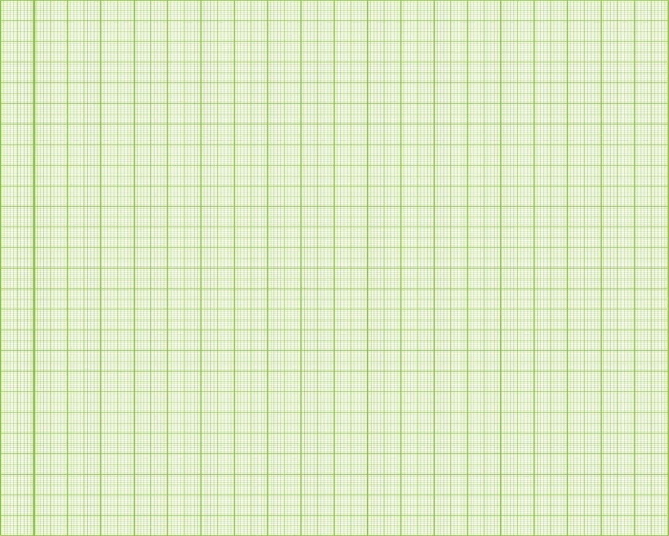
minimum class-size
=
5
y
We will take the simplest scale
1 cm = 1 unit
on ‘Y’ axis
The biggest adjusted frequency is
Since, in the list of classes we have numbers like 45, we put numbers 5, 15, 25 on the ‘X’x axis
For each class we will draw rectangle of length equal to the adjusted frequency
Since, the classes are starting from ‘0’ and the first class is 0 to 10
Marks
Freq.
Min. class-size
On the ‘X’ axis starting from ‘0’ we will leave 2 cm and then write 10
Adj. freq.
Adj. freq.
=
×
its freq.
size of this class
And further after
2 cm we write
20, 30, 40….
5
Min. class-size
0 – 10
8
Adj. freq.
=
×
×
8
=
4
size of this class
its freq.
10
10 – 30
32
5
×
32
=
8
10
20
9
8
30 – 45
18
5
×
18
=
6
7
15
6
Number of Students
5
5
4
45 – 50
10
×
10
=
10
3
5
2
5
1
X
50 – 60
6
×
6
=
3
10
0
5
10
15
20
25
30
35
40
45
50
55
60
Marks

Slide 22
Thank You

